Slide 1
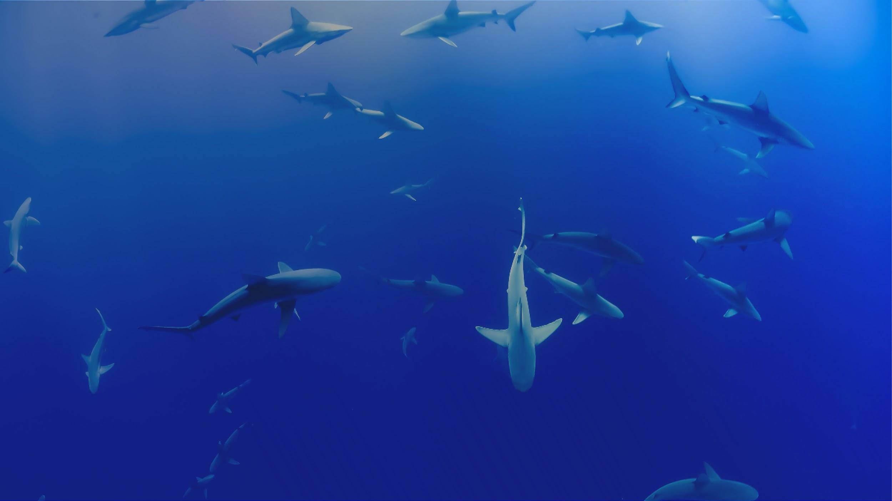

PRESENTATION TITLE
Author Name, Affiliation

Slide 2
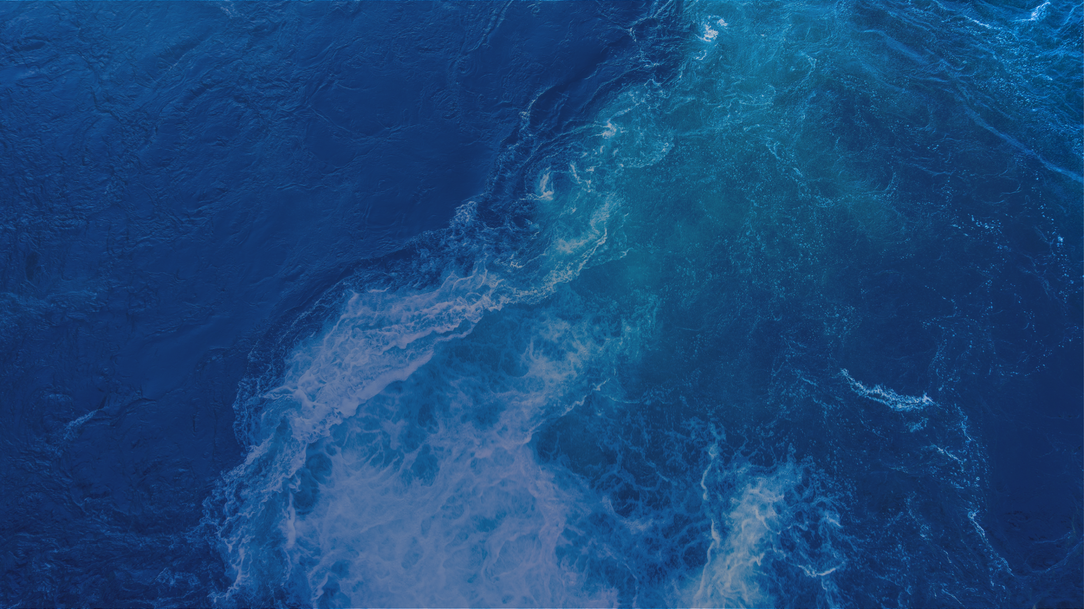

ABOUT OTN
Global aquatic research, data management and partnership platform headquartered at Dalhousie University in Nova Scotia, Canada.
Since 2008, OTN has been deploying state-of-the-art ocean monitoring equipment and marine autonomous vehicles (gliders) in key aquatic locations.
OTN has established partnerships with a global community of stakeholders to document the movements and survival of aquatic animals in the context of changing ocean environments.
Knowledge generated by OTN is used by scientists, managers, policy-makers, industry, Indigenous and coastal communities and the general public.
OCEAN TRACKING NETWORK

Slide 3

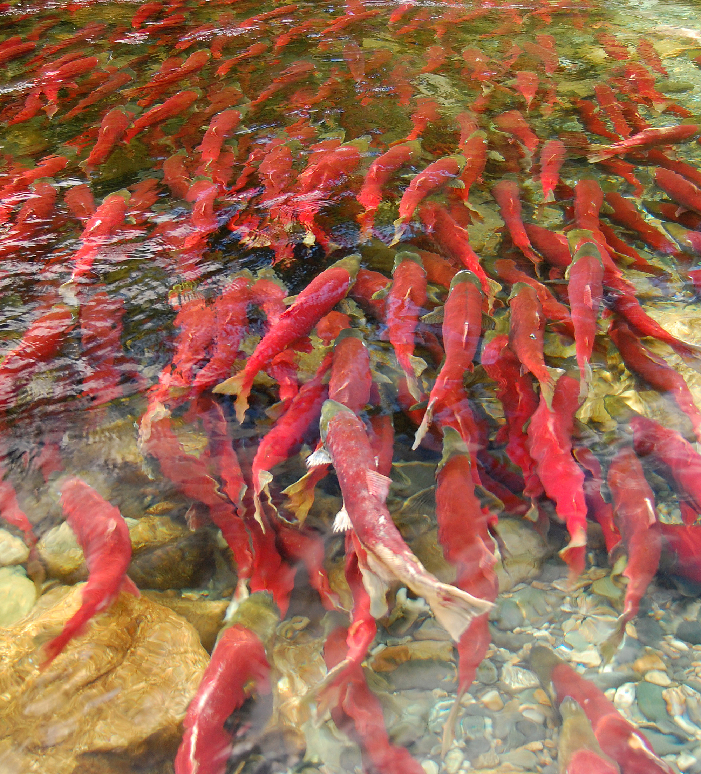
MISSION & VISION
To inform the sustainable management of aquatic animals by providing knowledge on their movements, habitats and survival in the face of a changing global environment
Sustainable management and use of ocean resources
Engaged and informed stakeholders
Sharing resources, abilities and data
OCEAN TRACKING NETWORK

Slide 4
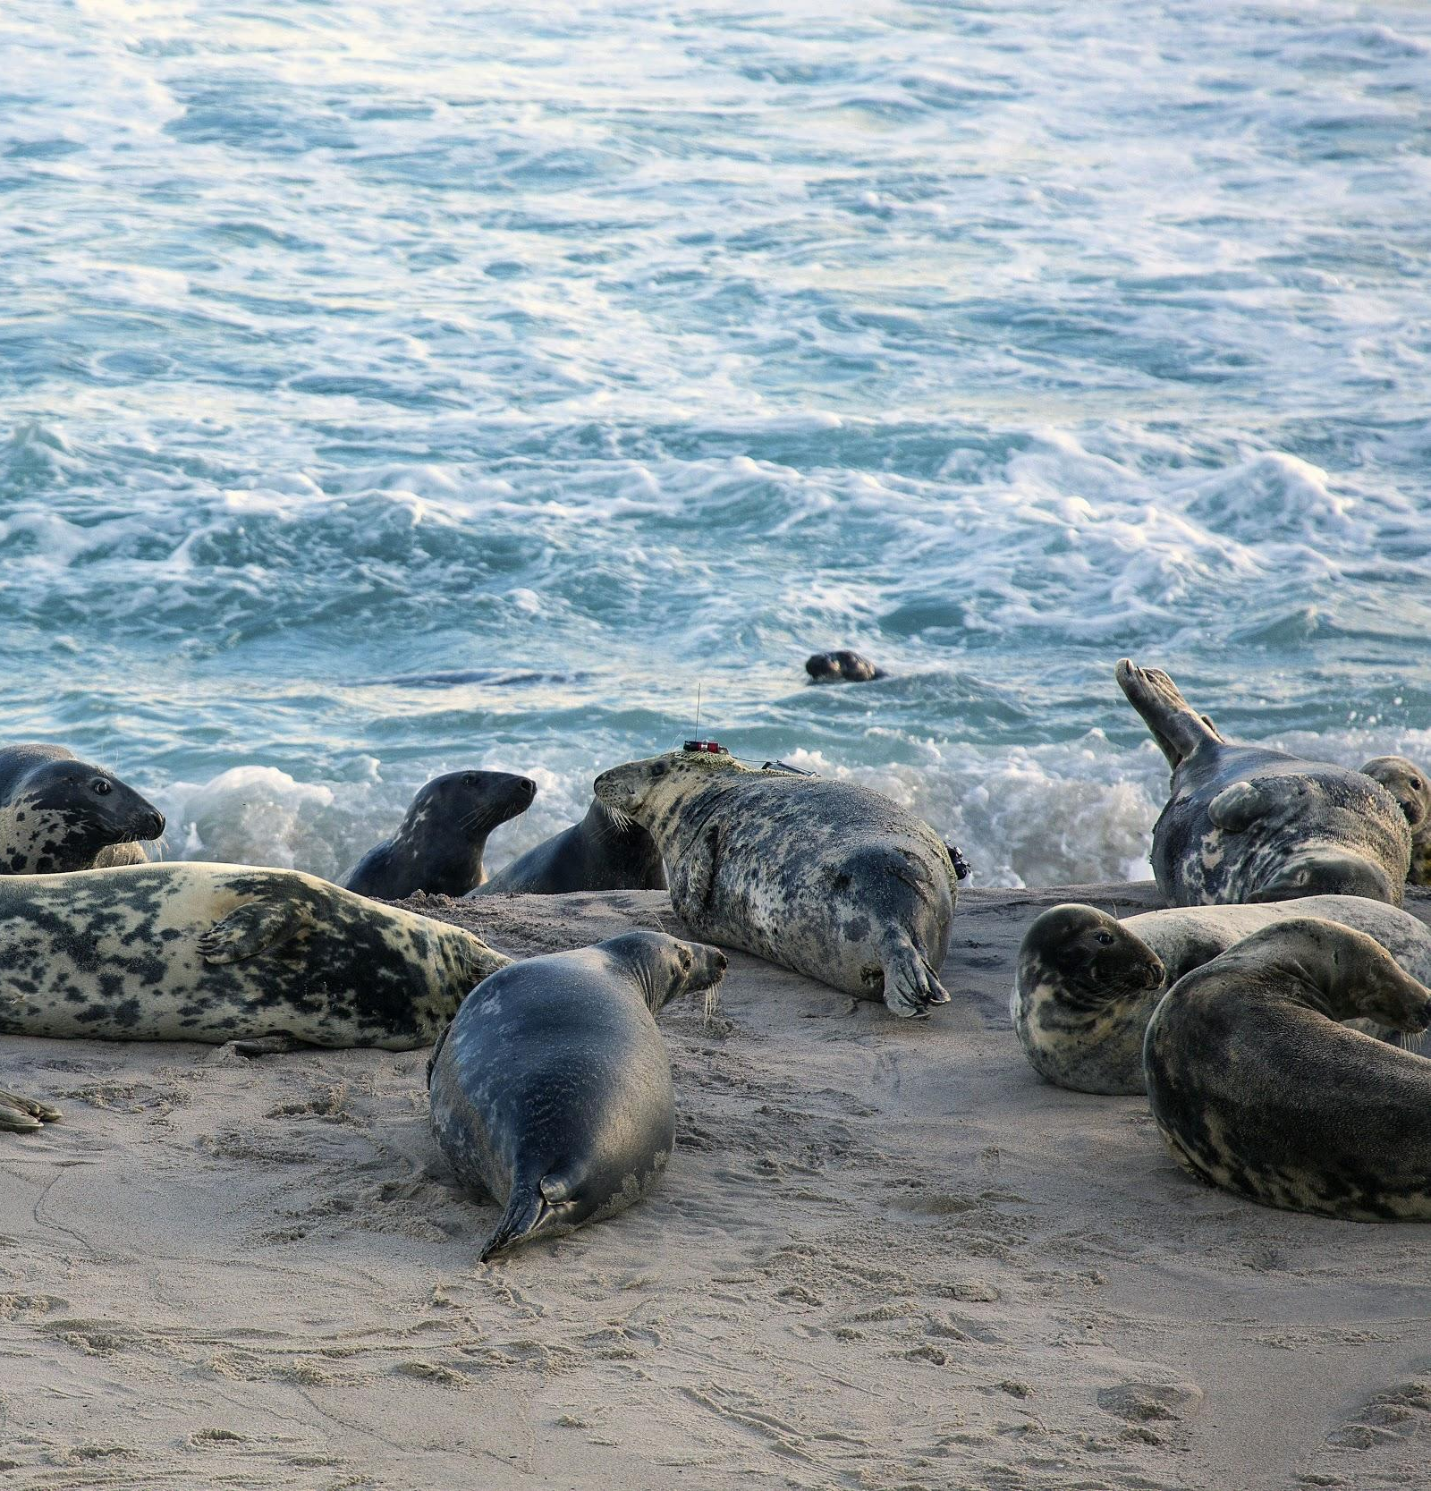
WHY TRACK?
Filling knowledge gaps in the animal telemetry index
Fisheries management (equitable quotas; monitoring)
Design of Marine Protected Areas
Impact assessment for coastal/offshore (Maritime Link; tidal power)
Endangered species research (white shark, Atlantic salmon)
Wild fish interactions with farmed fish
Environmental conditions and the prediction of future animal distributions
Assess habitat repairs and fate of hatchery fish
Engagement of the public
OCEAN TRACKING NETWORK

Slide 5
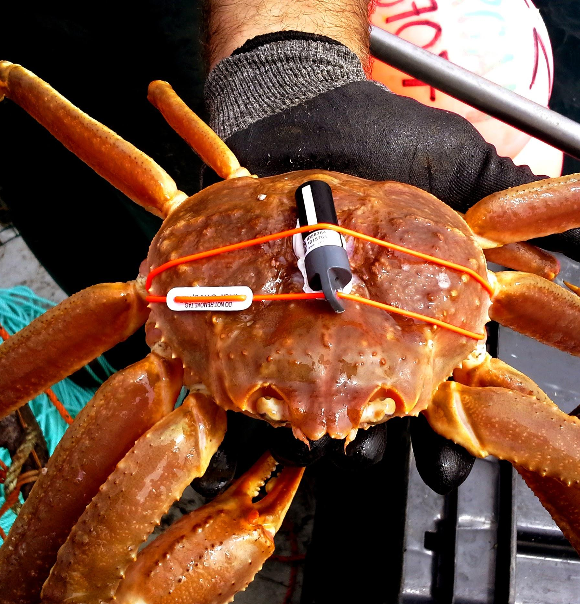
AQUATIC ANIMALS
Highly valued aquatic resources in a rapidly changing environment
Global food security
Billions of dollars per year in socioeconomic benefits
Structure healthy ecosystems and their resilience
Biological Essential Ocean Variables (GOOS)
Are culturally and globally significant
OCEAN TRACKING NETWORK

Slide 6
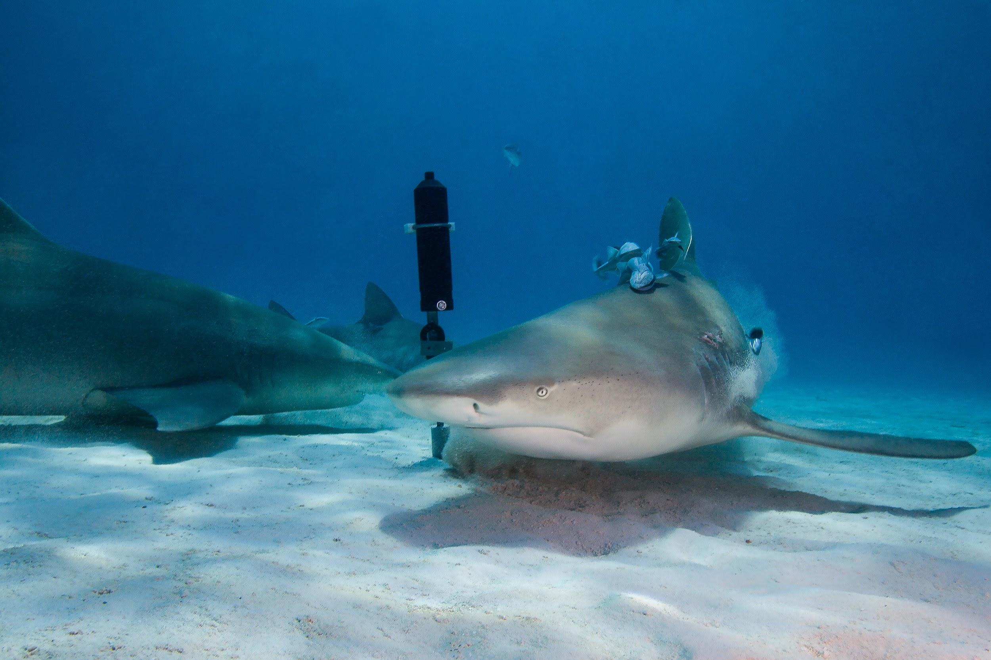
TAG TECHNOLOGY
Acoustic tags, satellite tags and data loggers
New tags have advanced the concept of mobile tracking to include large aquatic animals capable of documenting interactions with their surroundings, including environmental conditions and other tagged animals.
OCEAN TRACKING NETWORK

Slide 7
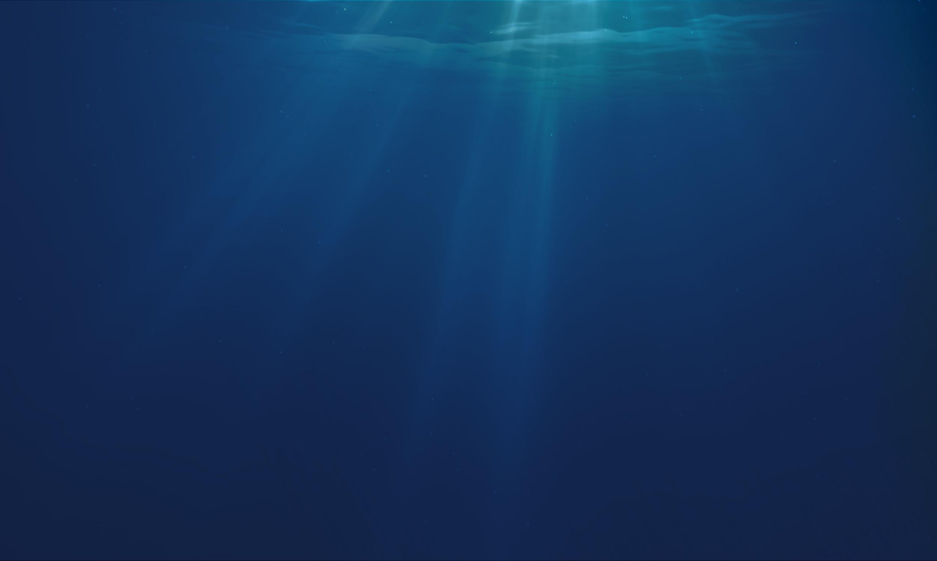
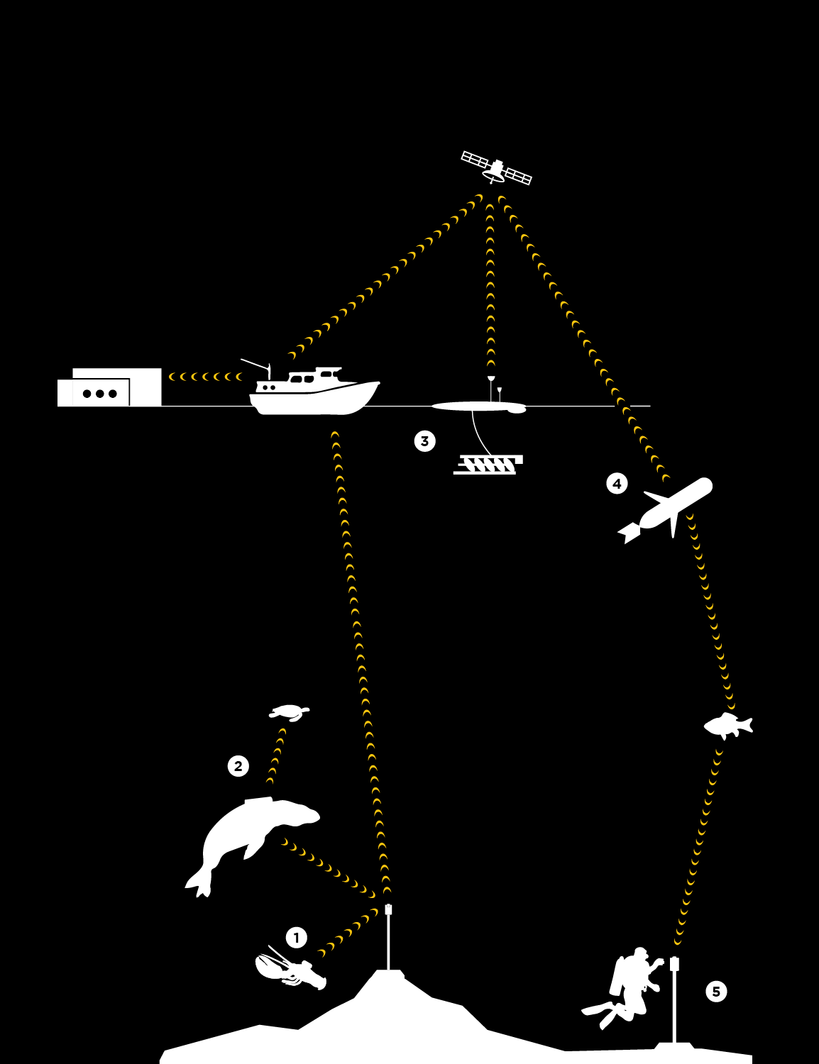
HOW TRACKING WORKS
Acoustic tags are small transmitters that allow researchers to track aquatic animals underwater.
Larger animals can carry Vemco Mobile Transceivers (VMTs), which act as both transmitters and receivers.
Wave Gliders float on the ocean’s surface. They are emission free, propelled by wave energy and solar powered.
Slocum Gliders dive up and down collecting information underneath the waves.
Acoustic receivers capture animal movement data.
OCEAN TRACKING NETWORK

Slide 8
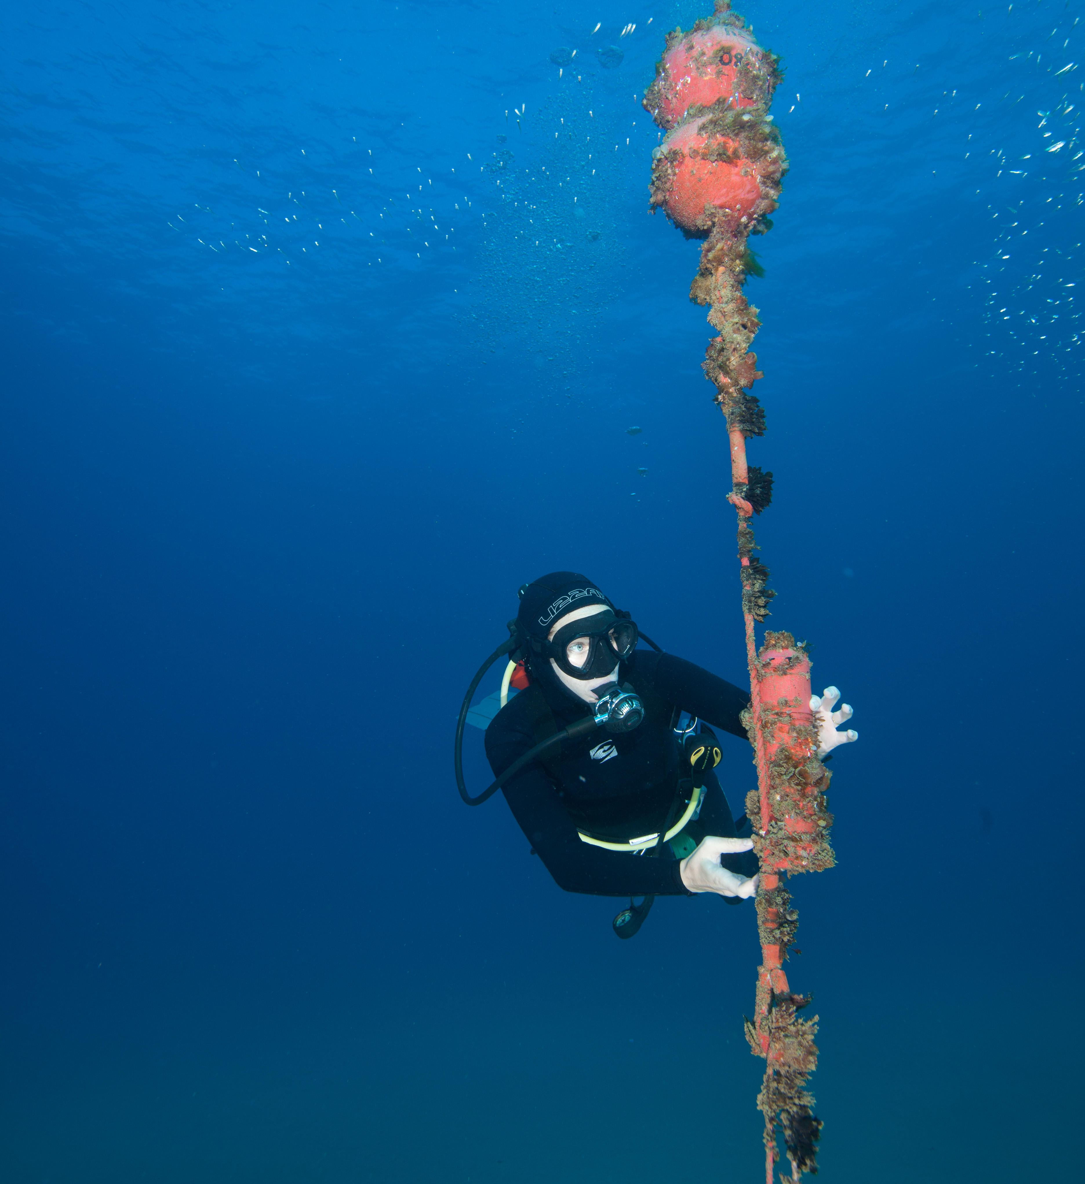
ACOUSTIC RECEIVER MOORINGS
Recovery timelines
Rollovers
Offloads
Bluetooth
Acoustic
OCEAN TRACKING NETWORK

Slide 9
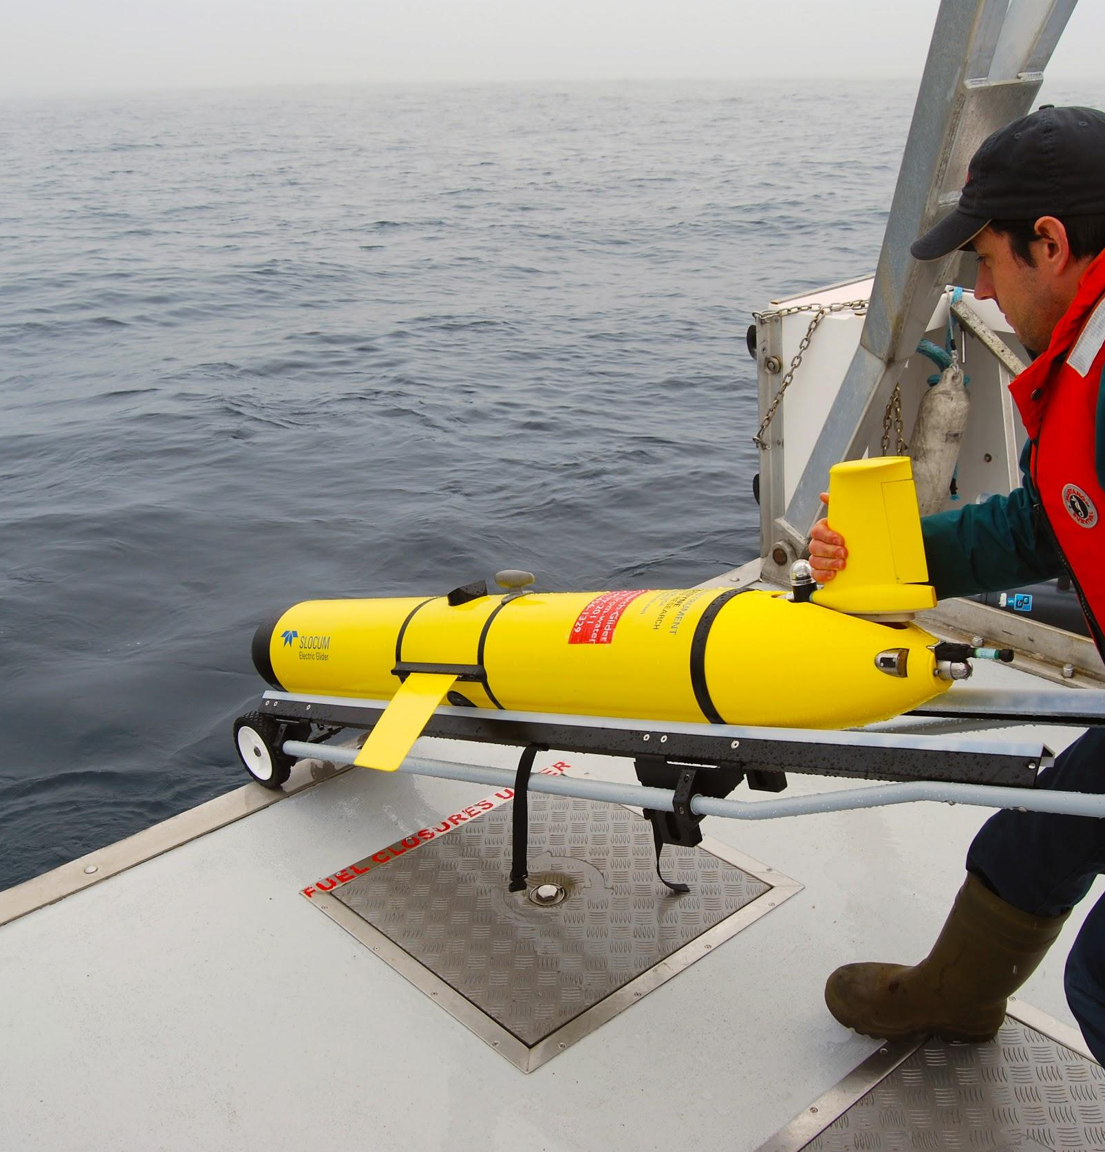
GLIDERS
Changing the way we study the ocean
Emission-free, cost-effective, and autonomous
Remotely offloads fixed tracking stations
Provides oceanographic context and equipment to track animals
Doesn’t get sea sick!
Wave glider: wave driven, powered by solar energy
Slocum glider: buoyancy driven, powered by lithium battery
More than____ km travelled since…
OCEAN TRACKING NETWORK

Slide 10
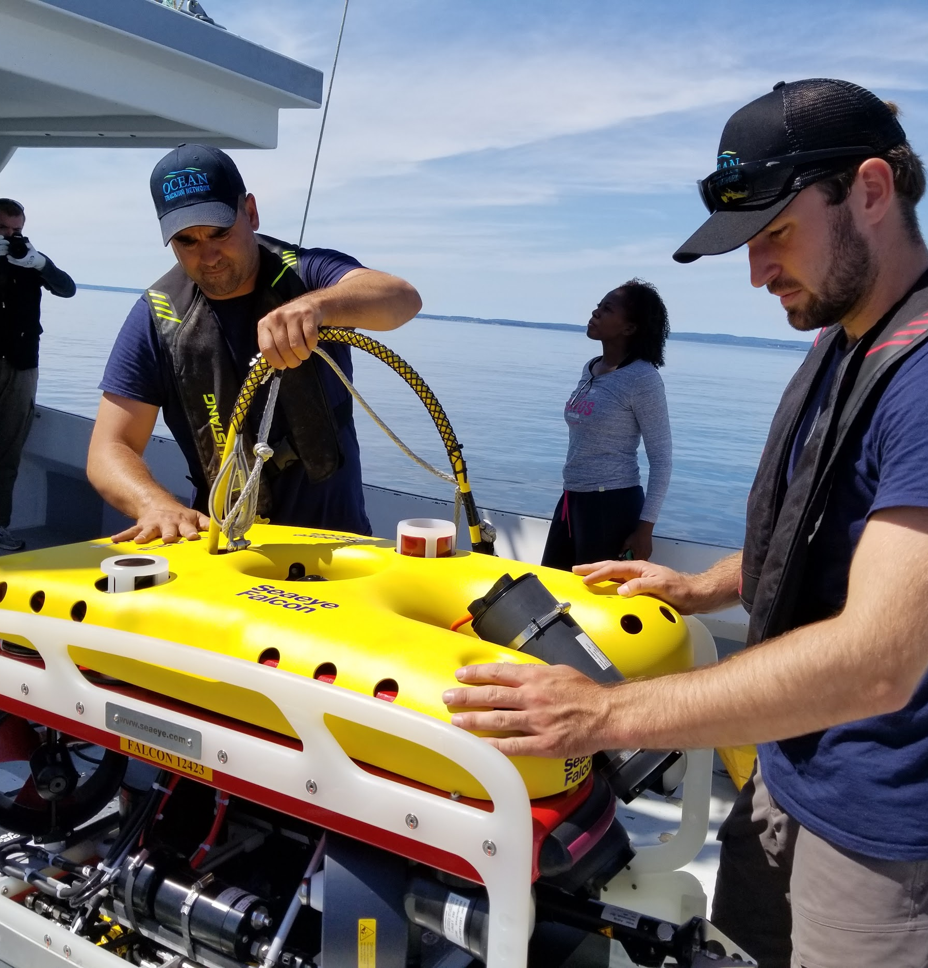
ROV: REMOTELY OPERATED VEHICLE
Saab Seaeye Falcon
Depth Rating up to 300 metres
Alternative recovery method
Film footage
Other projects
OCEAN TRACKING NETWORK

Slide 11
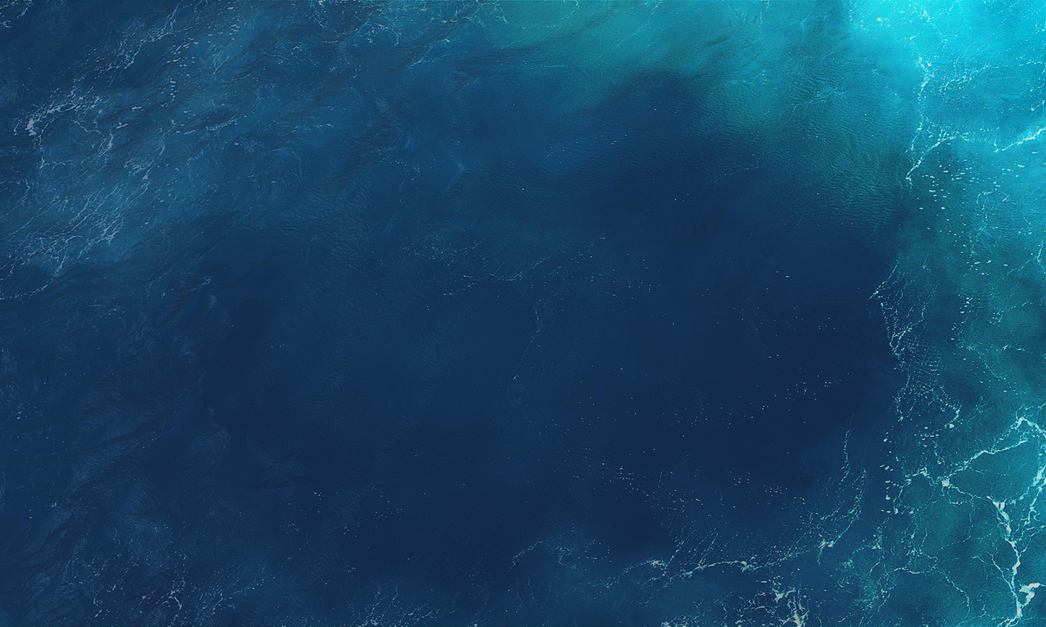
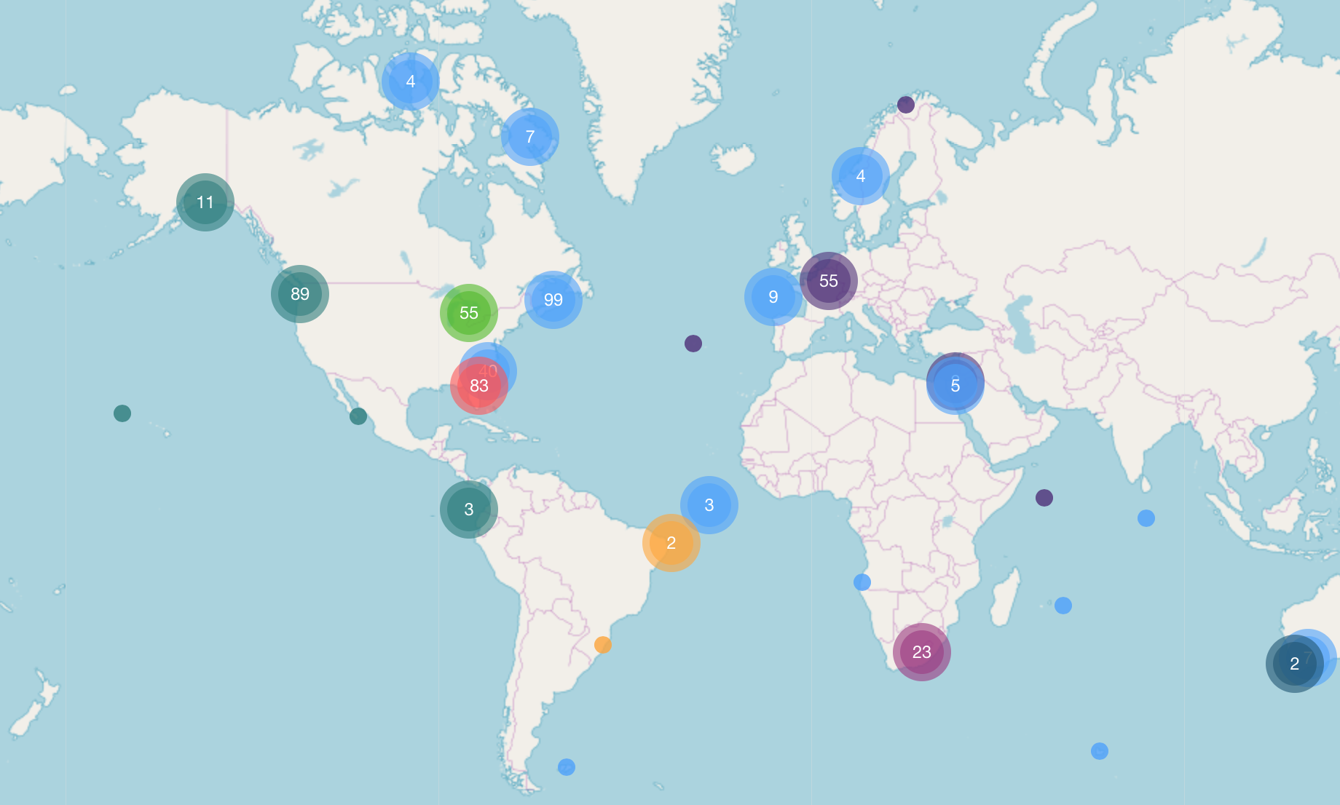
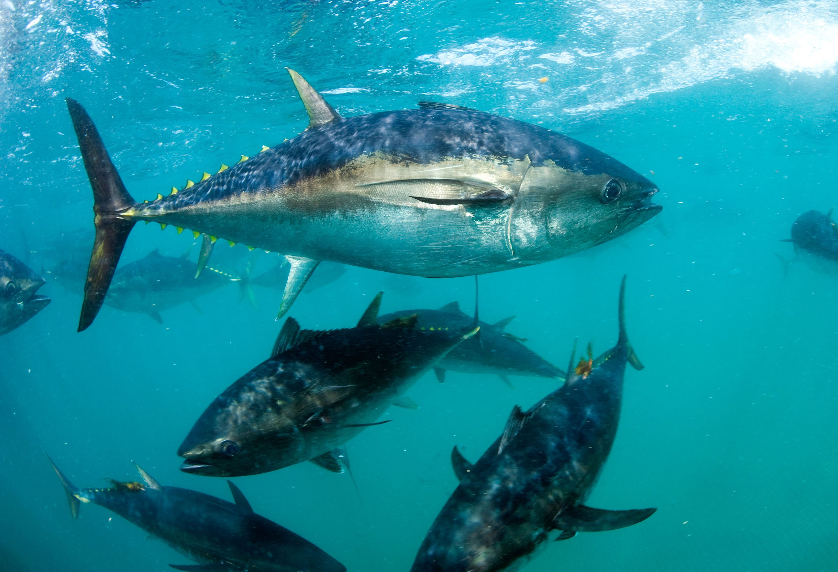
TRACK, CONNECT, TRANSFORM
Together, OTN and its collaborators are tracking oceans, connecting people and transforming knowledge
TRACK Using electronic tags to track more than 225 keystone, commercially important and endangered species.
CONNECT Connecting infrastructure, communities, resources, researchers, policy-makers, industry, and other stakeholders at local and global scales
TRANSFORM Transforming our understanding of the oceans by developing global data standards and a paradigm of collaborative research and management.
OCEAN TRACKING NETWORK

Slide 12
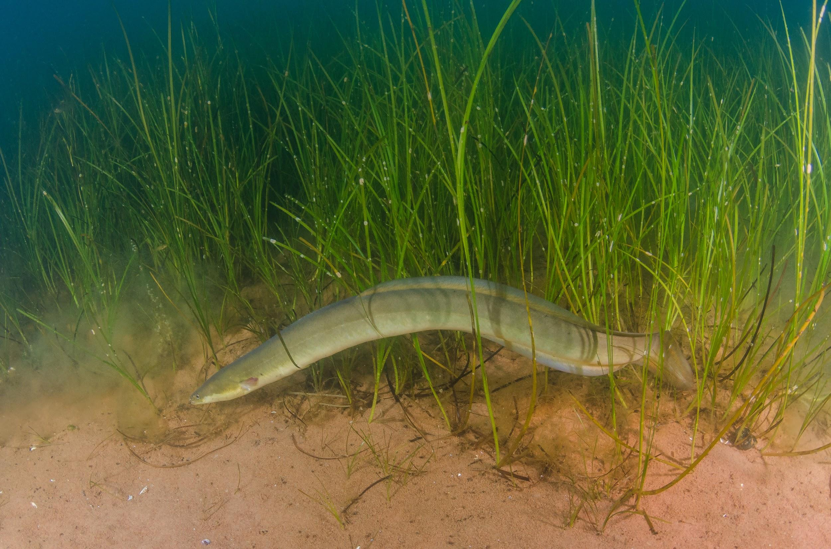
TRACK
Mysterious migrations of American eels
American eels are one of the most endangered fishes in North America
Their story begins and (usually) ends in the Sargasso Sea
Migrate to inland waters for 10 to 25 years
Return to Sargasso Sea to spawn
Journey first tracked by OTN researchers; revealed two-phase migration
Understanding routes and migration cues will help with conservation planning
OCEAN TRACKING NETWORK

Slide 13
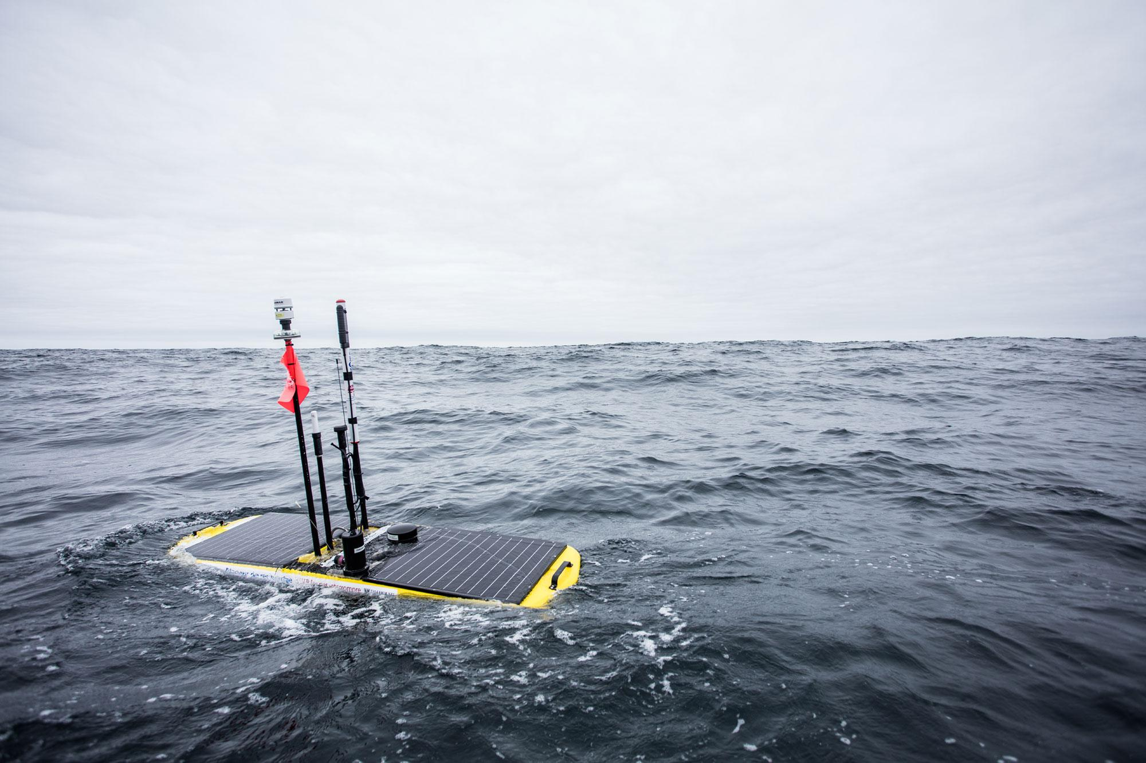
CONNECT
Underwater robots tracking right whales and their prey
Gliders listen for baleen whale calls off the Scotian Shelf and Gulf of St. Lawrence
Capture the abundance of whale prey: zooplankton
Partnership with Canadian Wildlife Federation & MEOPAR (WHaLE)
Understand migration routes and habitat use
Scientific basis to establish policy and protected habitats
Reduce accidental ship strikes and fishing gear entanglements
OCEAN TRACKING NETWORK

Slide 14
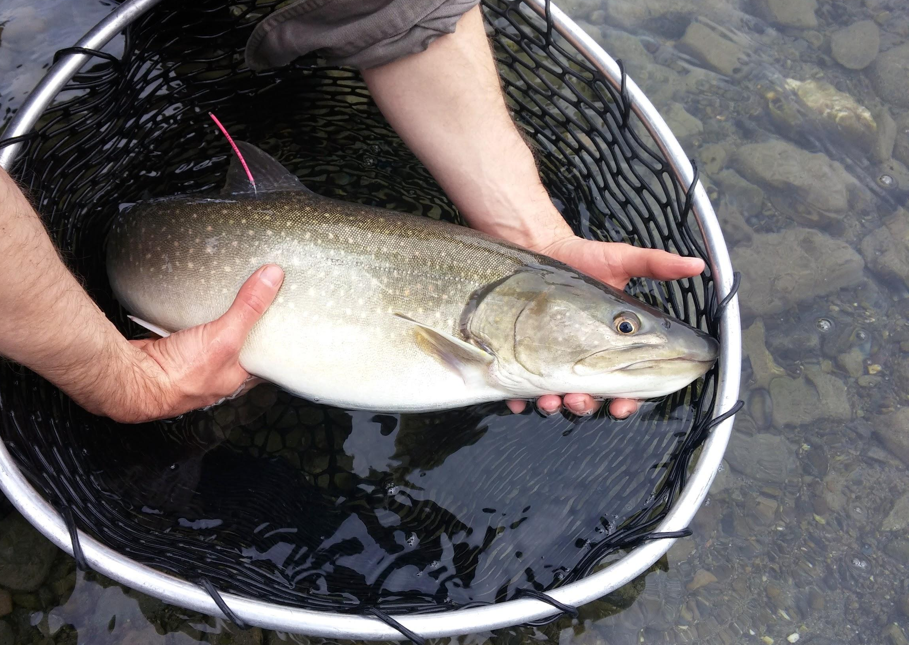
TRANSFORM
First Nations Fisheries
Most Pacific salmon migrate in to the open ocean only once in their lives
Return to natal spawning grounds
Heavily targeted by fisheries
OTN is generating movement data in partnership with DFO, Indigenous peoples, ENGOs & harvesters
Transforming fisheries management approaches
Boosting conservation of Pacific salmon in B.C.
OCEAN TRACKING NETWORK

Slide 15
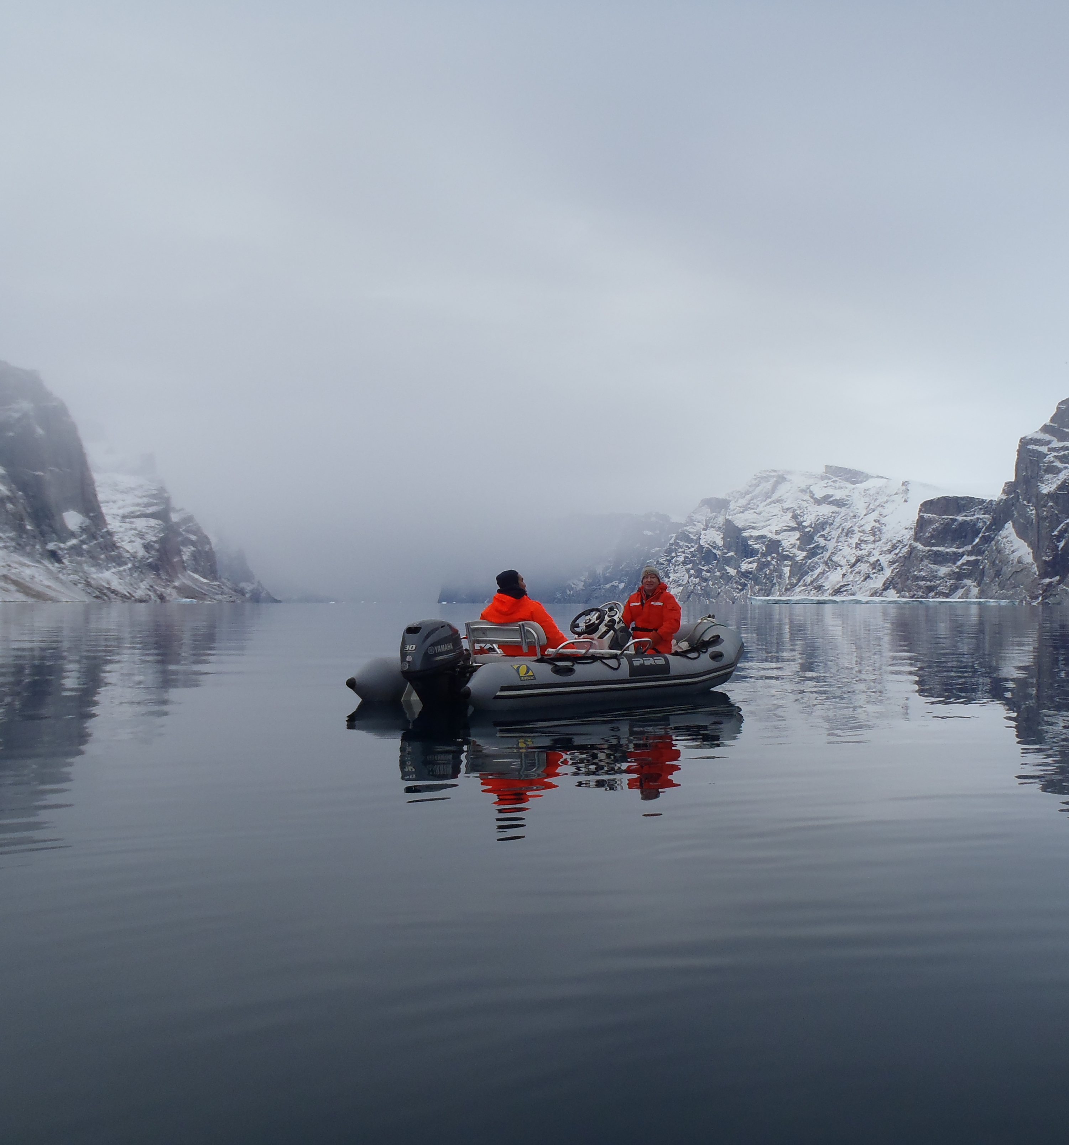
INFORMING POLICY
Sustainable management of emerging fisheries
1960s: Inuit communities developed Greenland halibut fishery in northern Cumberland Sound, N.U.
Divided from international fishing waters in southern portion of the Sound
Halibut populations were thought to be distinct
OTN research showed fish were crossing north and south boundary on a seasonal basis
Management line has been moved to encompass entire Cumberland Sound
More sustainable for both the Greenland halibut population and the community
OCEAN TRACKING NETWORK

Slide 16
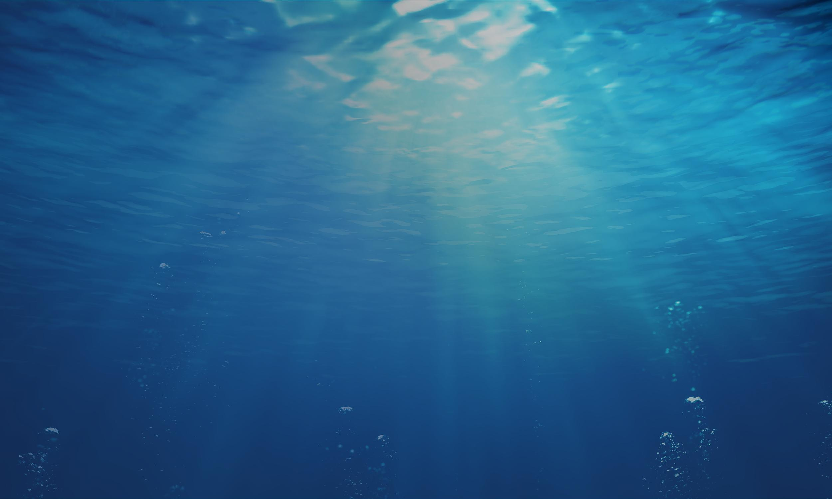
OTN IN NUMBERS
47,500
614
212
75,000
TAGGED ANIMALS TRACKED
SENIOR SCIENTISTS
SPECIES TRACKED
GLOBALLY
KM COVERED BY GLIDERS
OCEAN TRACKING NETWORK

Slide 17



@oceantrackingnetwork
@oceantracking
oceantrackingnetwork.org

